Slide 1
Efficiency losses through Fragmentation? Scale effects in European ANS Provision
Thomas Standfuß
(DLR German Aerospace Center Braunschweig)
Prof. Dr. Frank Fichert
(University of Applied Sciences Worms)
Dr. Michael Schultz
(Technical University of Dresden)
Petros Stratis
(Ministry of Transport, Communication and Works, Cyprus)
Research Workshop Fragmentation in Air Traffic and its Impact on ATM Performance
Budapest, 14 May 2019

Slide 2
Agenda
Background
Structural Fragmentation
Economies of Scale in European ATM
Conclusions

Slide 3
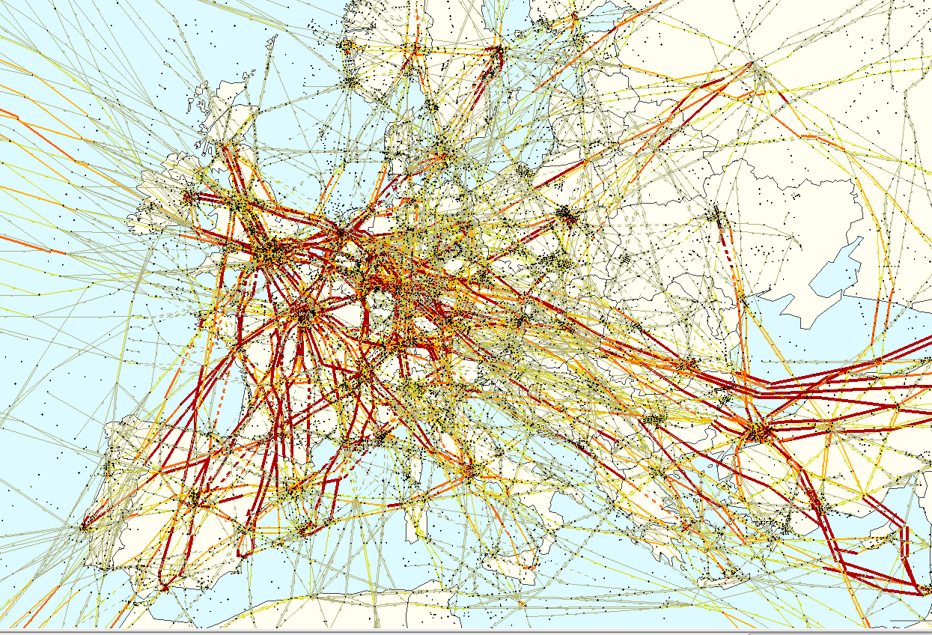
Background (1) – Demand for Air Navigation Services (ANS) in Europe
One of the busiest airspaces in the world:
30,000 flights per day on average, peak ~ 36,000 flights per day (2017)
37,101 flights on 07 Sept. 2018
Spatial distribution:
Hot spots especially in the core area
Lower demand in north and north east Europe
Challenges:
Seven large airports within a diameter of 1,000km
Traffic flow and distribution is volatile, e.g. due to weather / environment, political crises or strikes
Source: NEST

Slide 4
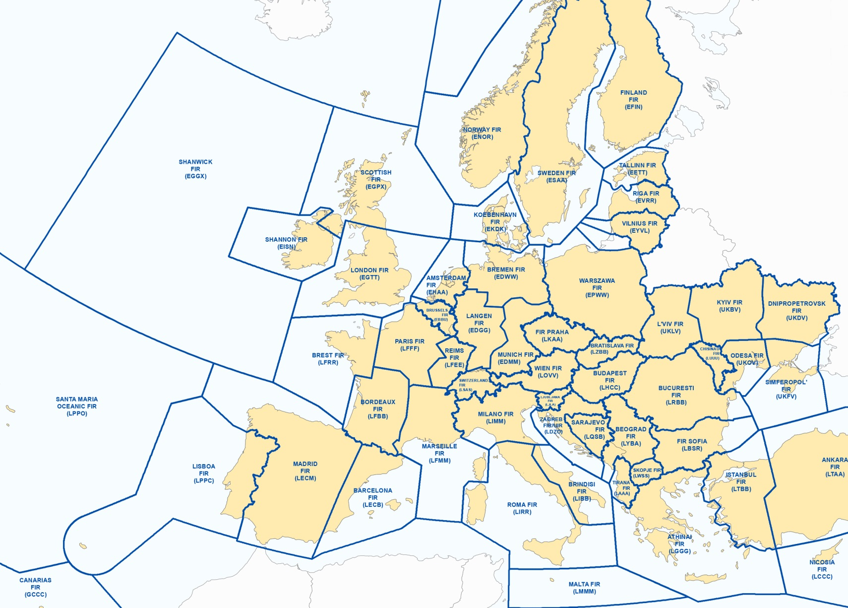
Background (2) – ANS Provision in Europe
“Fragmented Airspace”
38 Air Navigation Service Providers (ANSPs)
63 Area Control Center (ACCs)
High level of heterogeneity regarding
Provided services and covered airspaces
Systems and tools
Working procedures
Data collection processes
Cost allocation
ANSP | Covered Airspaces
 | Upper | Lower | Terminal
Maastricht UAC | X
Belgocontrol |  | X | X
Skyguide | X | X | X
Source: Eurocontrol

Slide 5
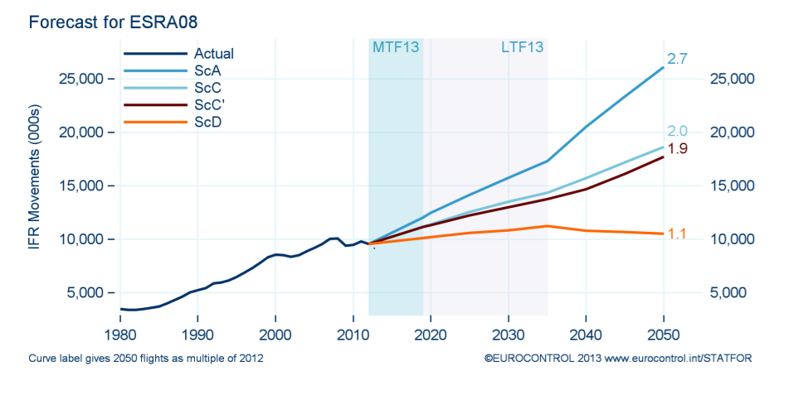
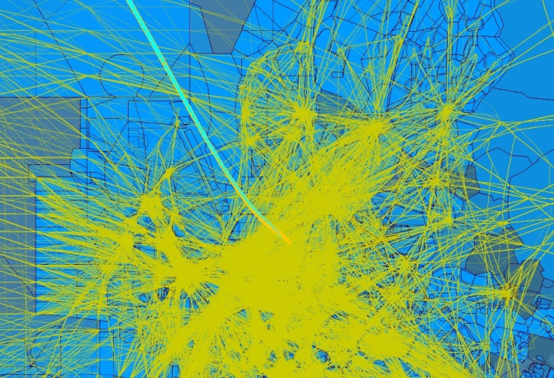
Background (3) – Future Challenges
Forecast versus actual development
Increasing traffic numbers expected
However: Uncertainties, regarding
Overall development
Flows and distribution
New Entrants (Space Vehicles, UAV,…)
Implementation of operational specifics into ATM
Analysis of the expected impact on operations
4D trajectory prediction
Consideration of hazard areas

Slide 6
Structural Fragmentation (1)

Slide 7
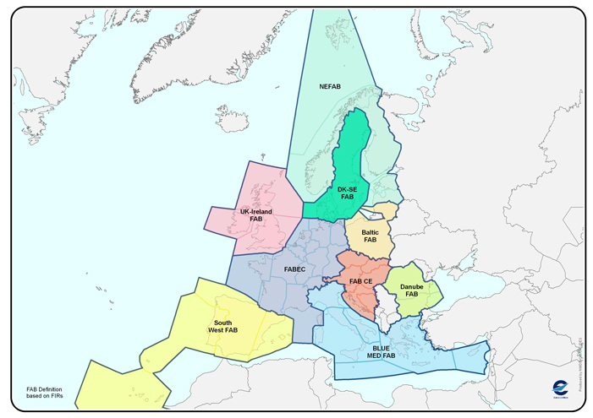
Structural Fragmentation (2)
(Annual) Official Reports
Fragmentation contributes to inefficiency in Europe
Proclaimed approach: Functional airspace blocks
Single European Sky:
9 FABs constructed
Interoperability of systems and tools demanded (technical fragmentation)
However, it’s not clear for which ANSPs economies of scale may exist
Source: EUROCONTROL
Notes:
Revolution in the economic and regulatory landscape of air transport in Europe on the last 20 years
Before 1987, national markets within the EU were protected and fragmented
Three successive packages of liberalisation measures (1987- 1992) have changed the map
Largest and most successful example of regional market integration and liberalisation
After the liberalisation of traffic in 1990s EU experienced a level of unprecedented deterioration in on-time performance of air carriers - One of the reasons identified was the underperformance of the ATM systems: ageing technologies and systems will face considerable traffic increase by 2020 - Other important reason: fragmentation of European skies - High Level Group report in November 2000 - The EU responded with an ambitious regulatory initiative
Objectives:
To restructure European airspace as a function of air traffic flows, rather than according to national borders
To create additional capacity
To increase the overall efficiency of the ATM system
To enhance safety standards T

Slide 8
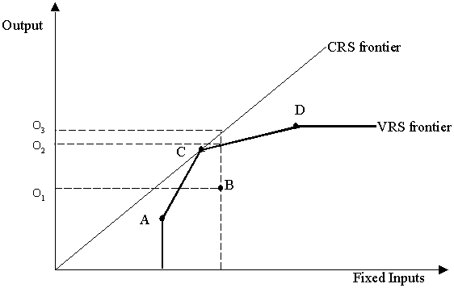
Economies of Scale in European ATM (1) - Approach
Research steps
Data analysis (2014 and 2016 PRU data)
Economic modelling
Applying benchmarking methodology (DEA)
Investigate returns to scale and scale efficiency
Analysis of correlation to complexity and airspace size
Conclusions regarding FAB structure
Economic modelling
Multiple factors mandatory (Input and Output)
Input should be covered comprehensively
Operational indicators are more reliable (differing accounting standards, wage effects, etc.)
Input orientation (minimization approach)
.
Source: fao.org

Slide 9
Economies of Scale in European ATM (2) - Models
Model | Inputs | Outputs
1 | ATCO-hrs on duty Operational cost exclud. ATCO costs CIU (fixed) | IFR flight hours Airport movements
2 |  | CFH (fixed)
2A |  | CFH (fixed)
2B | ATCO-hrs on duty Operational cost exclud. ATCO costs CIU (var) | CFH (var)
Model specifications
Design of four models
Basic model 1: 2 outputs, 3 inputs
Model 2: Consolidation of outputs to CFH (fixed)
Model 2A: Maastricht excluded
Model 2B: Adjusted composite indicators (var.)
.
$${CIU}_{Var}=\frac{ATMCNS cost of terminal services}{Total gate−to−gate costs}×Number of Towers+\frac{ATMCNS cost of enroute services}{Total gate−to−gate costs} ×Number of ACCs$$
$${CFH}_{Var}=\frac{ATMCNS cost of terminal services}{Total gate−to−gate costs}×Airport Movements+\frac{ATMCNS cost of enroute services}{Total gate−to−gate costs} ×IFR Flight hours$$

Slide 10
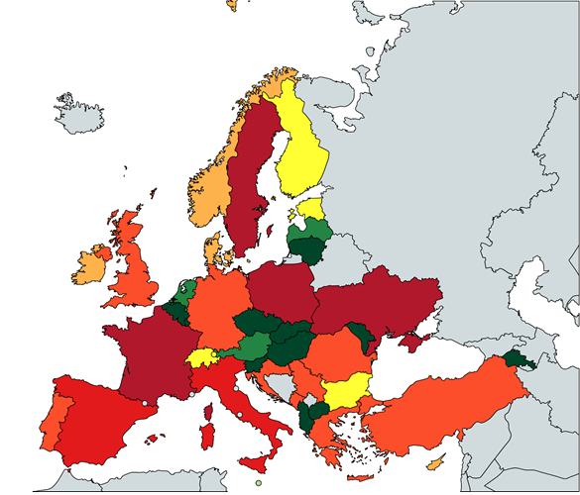
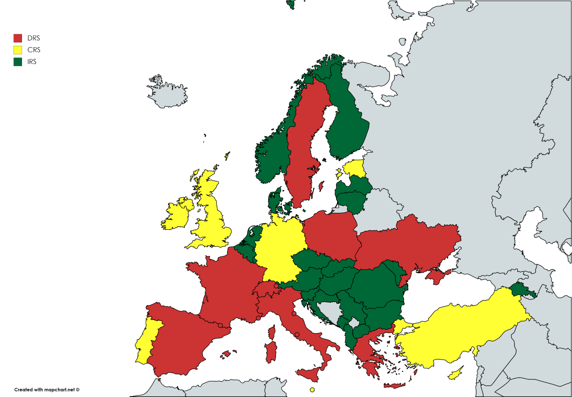
Economies of Scale in European ATM (3) – Results (1)
Scale Indicator (left) and Economies of scale for Model 2A (right) - 2014 data
Source: Standfuss, Fichert and Schultz (2017): Efficiency gains through Functional Airspace Blocks? - An analysis of Economies of Scale in European Air Traffic Management

Slide 11
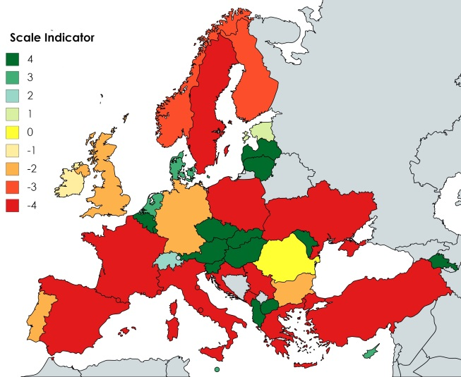
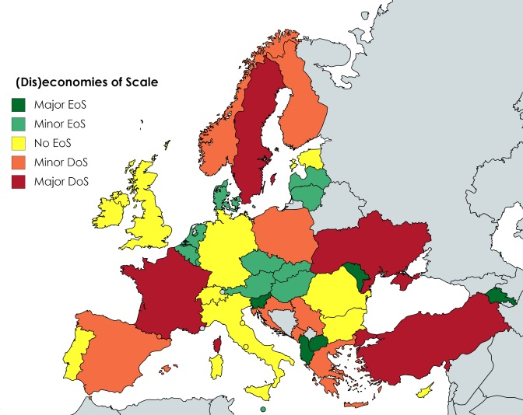
Economies of Scale in European ATM (4) – Results (2)
Scale Indicator (left) and Economies of scale for Model 2A (right) - 2016 data

Slide 12
Economies of Scale in European ATM (5) – Results (3)

Slide 13
Economies of Scale in European ATM (6) – Results (4)

Slide 14
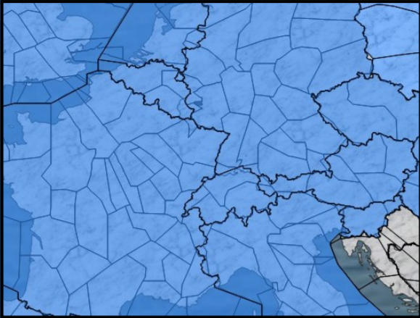
Conclusions
The results show that airspace structure is an important factor of (in)efficiency in European ATM
There are minor differences between the results of 2014 and 2016 dataset, partially caused by geopolitical developments
In general:
Reducing the fragmentation could improve efficiency for some ANSPs
Results suggest a turning point where decreasing returns to scale appear
It is not clear whether a close cooperation between a small ANSP (with increasing returns to scale) and its neighboring large ANSP (with decreasing returns to scale) is pursued
Future ATM concepts may represent alternatives to a fixed airspace structure, e.g.
Dynamic Sectorization
Sectorless ATM
Source: ICAO, Single European Sky and Functional Airspace Blocks
Notes:
MUAC

Slide 15
Thank you for your attention Efficiency losses through Fragmentation? - Scale effects in European ANS Provision Deutsches Zentrum für Luft- und Raumfahrt e.V. (DLR) German Aerospace Center Institute of Flight Guidance Thomas Standfuß Department of Pilot Assistance Tel.: + 49 531 295-2274 thomas.standfuss@dlr.de

